Slide 1
Spring Cloud Config
February 2019

Slide 2
Config in a Spring Context
Configuration in a Spring context can usually be described as values that wire up Spring beans. Spring has provided several approaches to setting config, including externalizing (via Command Line arguments, Env Variables, etc.) Still, gaps exist:
Changes to config require restarts
No audit trail
Config is de-centralized
No support for sensitive information (no encryption capabilities)

Slide 3
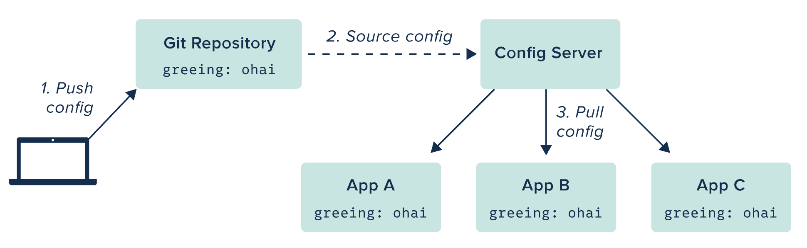
Spring Cloud Config

Slide 4
Spring Cloud Config Server
The Server provides an HTTP, resource-based API for external configuration (name-value pairs, or equivalent YAML content). Bind to the Config Server and initialize Spring Environment with remote property sources Embeddable easily in a Spring Boot application using @EnableConfigServer Encrypt and decrypt property values (symmetric or asymmetric)

Slide 5
Spring Cloud Config Server
@SpringBootApplication
@EnableConfigServer
public class ConfigServer {
public static void main(String[] args) {
SpringApplication.run(ConfigServer.class, args);
}
}
application.yml
http://github.com/<repo>/<my-repo>/blob/master/demo.yml
spring:
cloud:
config:
server:
git:
uri: http://github.com/<repo>/<my-repo>.git
Greeting: Bonjour
Notes:
The server is easily embeddable in a Spring Boot application using the@EnableConfigServer annotation. Application configuration data is stored in a backend Git, Subversion and File System backends are supported Git is the default backend. It's great for auditing changes and managing upgrades Setting the git backend is done via the spring.cloud.config.server.git.uri configuration property

Slide 6
Spring Cloud Config Client
@Configuration @EnableAutoConfiguration @RestController public class GreetingService { @AutoWired Greeter greeter; @RequestMapping("/") public String home() { return String.format("%s World", greeter.greeting); } @Component @RefreshScope public class Greeter { @Value("${greeting}") String name = "World"; } }
bootstrap.yml
spring: application name: demo cloud: config: uri: http://my-config-server.com
Notes:
Config server exposes config on the following endpoints:
/{application}/{profile}/[{label}] /{application}-{profile}.yml /{label}/{application}-{profile}.yml /{application}-{profile}.properties /{label}/{application}-{profile}.properties
{application} maps to "spring.application.name" on the client side;
{profile} maps to "spring.active.profiles" on the client (comma separated list); and
{label} which is a server side feature labelling a "versioned" set of config files.

Slide 7
Refreshing Configuration Context
@Component @RefreshScope public class Greeter { @Value("${greeting}") String name = "World"; }
Update Git Repository
Send a POST refresh request to the application(s) to refresh eg. curl –X POST http://my-app.com/refresh
Notes:
Requires the Actuator dependency on the classpath (pom.xml).

Slide 8

Refreshing Configuration Context
When running many applications, refreshing each one can be cumbersome. Instead, leverage Spring Cloud Bus pub/sub notification with RabbitMQ. Send a POST request to the refresh endpoint to fetch updated config values: http://my-app.com/bus/refresh
pom.xml
<dependency>
<groupId>org.springframework.cloud</groupId>
<artifactId>spring-cloud-starter-bus-amqp</artifactId>
</dependency>
Notes:
Requires the Cloud Bus AMQP dependency on the classpath (pom.xml).
<dependency>
<groupId>org.springframework.cloud</groupId>
<artifactId>spring-cloud-starter-bus-amqp</artifactId>
</dependency>

Slide 9
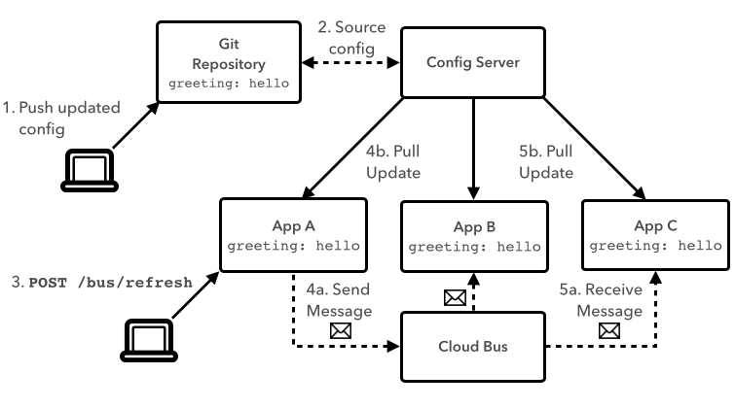
Refreshing Configuration Context

Slide 10
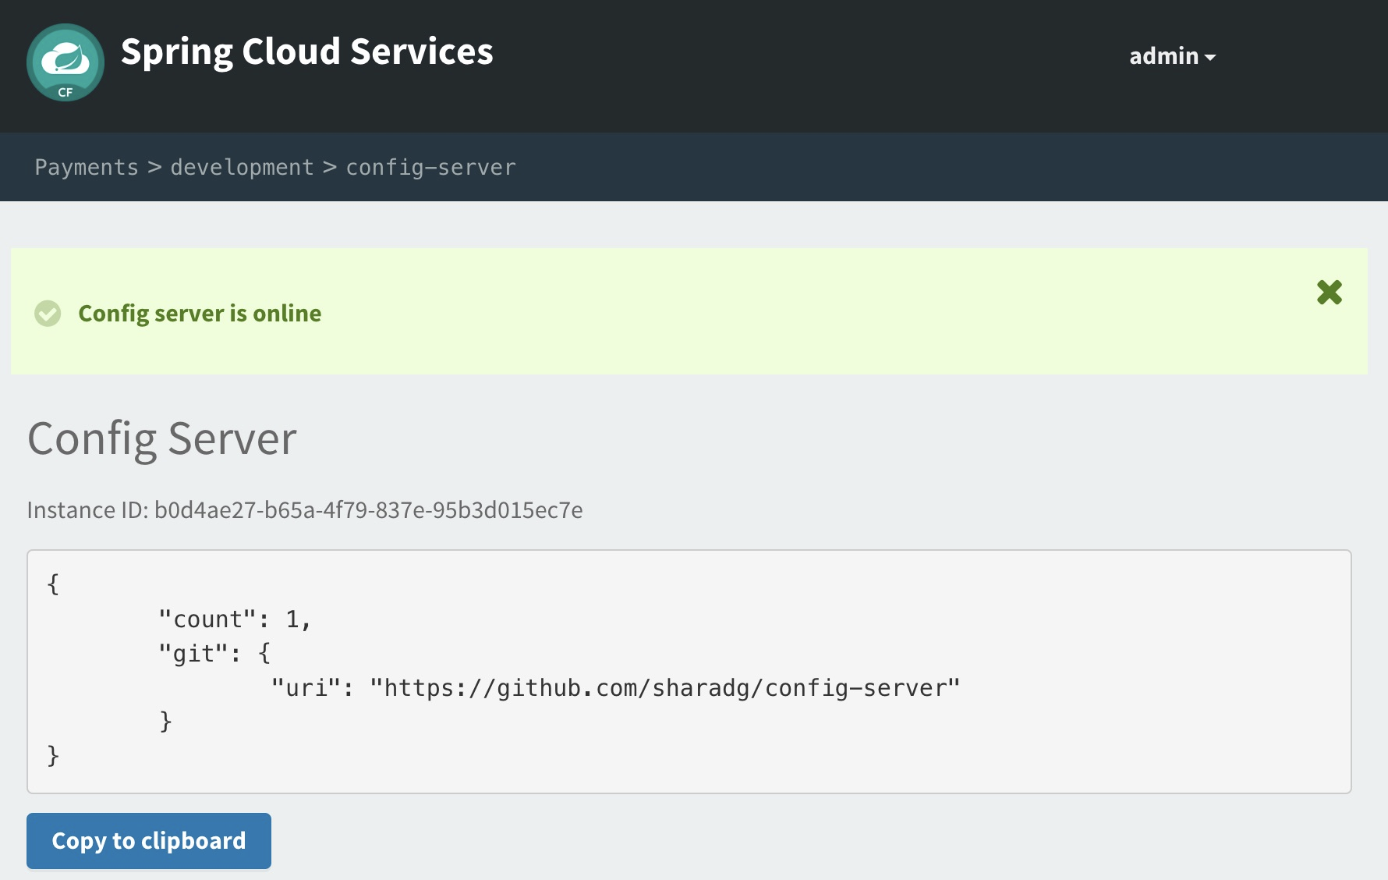
Spring Cloud Services: Config Server
Automated deployment of server component Simply specify Git URL Bind into CF application

Slide 11

Transforming How The World Builds Software
© Copyright 2017 Pivotal Software, Inc. All rights Reserved.

